Slide 1


SAP CLOUD APPLICATION PROGRAMMING AND XSA TRAINING IN BPT
Anubhav Oberoy
Day – 1

Slide 2

INTRODUCTION

Slide 3

Agenda – Day 1
Introduction to SAP BTP and Cloud Foundry
What is SAP BTP?
Setup Account for SAP
What is Cloud Foundry?
SAP Cloud Foundry Architecture
Why use Cloud Foundry
History of Cloud Foundry
Development Tools Setup
Deploying a sample application to CF

Slide 4
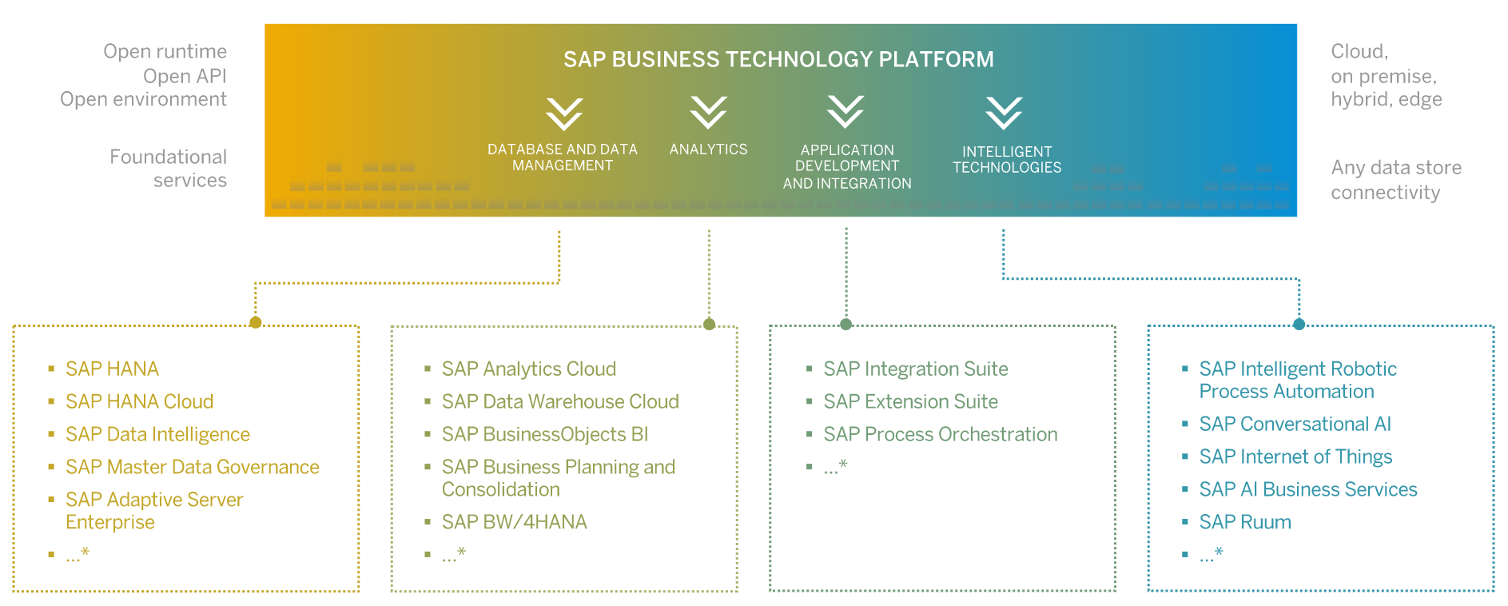
What is BTP?
SAP Business Technology Platform (SAP BTP) is an integrated offering comprised of four technology portfolios: database and data management, application development and integration, analytics, and intelligent technologies. The platform offers users the ability to turn data into business value, compose end-to-end business processes, and build and extend SAP applications quickly.

Slide 5
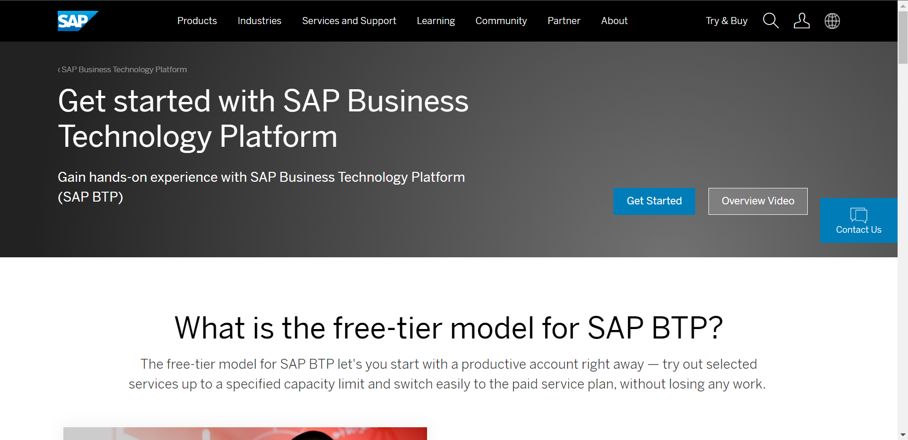
Setup Your FREE Account
To use SAP Business Technology Platform first you need to create a account on sap.
You can setup a free account for SAP at https://www.sap.com/products/cloud-platform.html
After account setup to access the Business Technology Platform trial account visit: https://account.hanatrial.ondemand.com/trial/#/home/trial

Slide 6




WHAT IS SAP CLOUD FOUNDRY?
Application
Application
Data
Data
Runtime
Platform as a Service
Managed by SAP implementing open source CF
Middleware
Fully ready landscape with reusable services
Scalability
Elasticity
Low TCO
Database
OS
Managed by Infrastructure
providers
Data Centers
Service Portfolio
Virtualization
Infrastructure as a Service
Servers
Storage
Networking

Slide 7
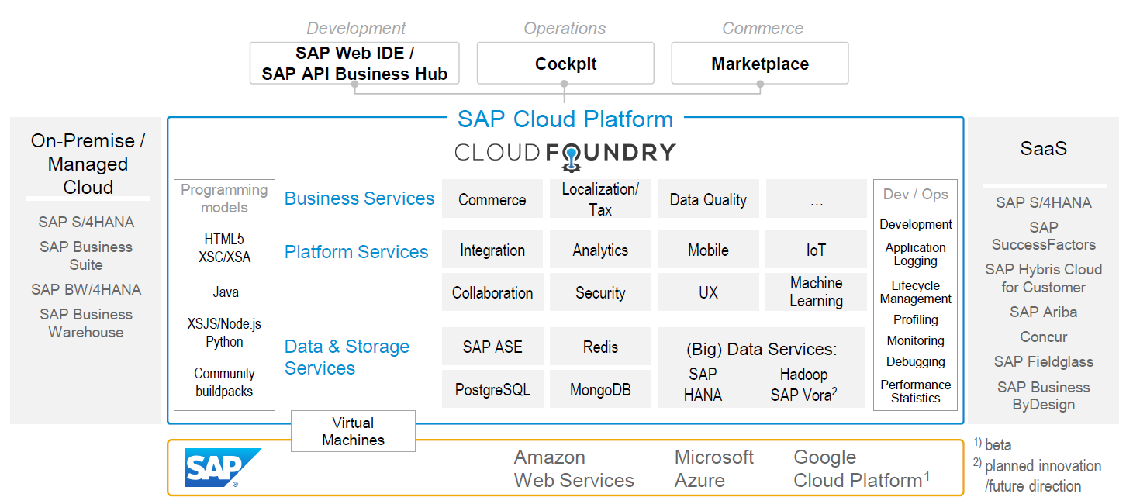
SAP CLOUD FOUNDRY ARCHITECTURE

Slide 8





Why CF (1)
1
Support full development lifecycle
Build Application & Services
Development
Continuous Delivery (CD) = Code ➔ Push ➔ Test ➔ Build
Continuous Integration (CI) = Dev ➔ Quality ➔ Production
Up and Down
Deployment
Testing
Monitor and Upgrade

Slide 9

Why CF (2)
2
Self healing container management system
Cell
Garden = execution
Containers
A

Slide 10
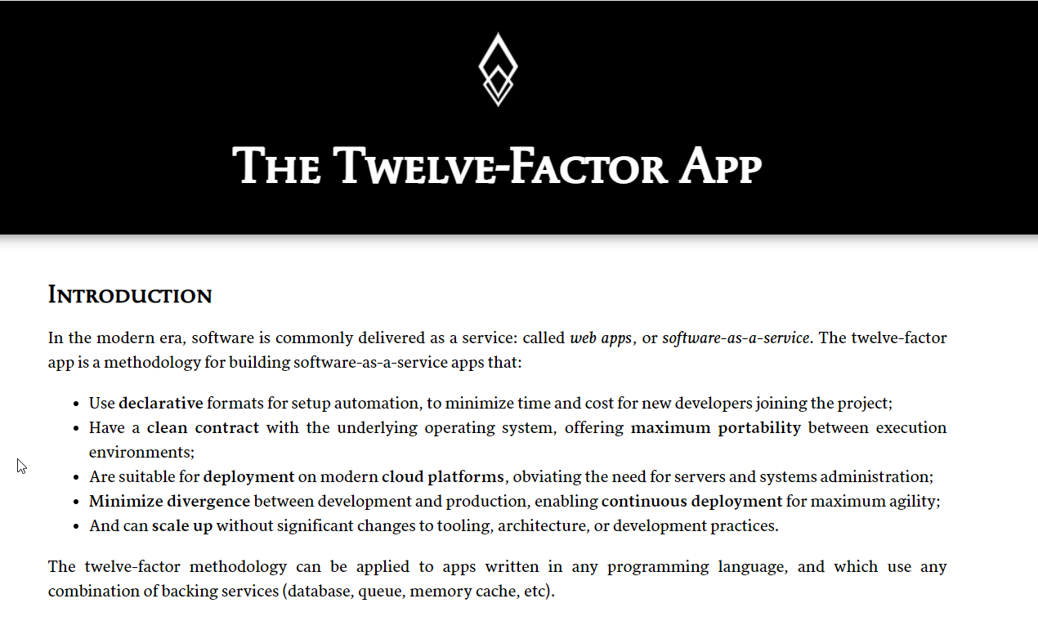

Why CF (3)
3
Support 12 Factor App
It is a strategy to build software-as-a-service
https://12factor.net/
A

Slide 11
History of CF
License: Apache 2.0
Build in Ruby, Java and Go
Open Governance Foundation
2009-2011
2012
2013
2014
2015
2019
2021
VMWare
BOSH
Open Source Tools
Seven platinum members and two gold members
40+ Members
65+ Members
Jan 2021
Pivotal Cloud foundry closes free trials
Pivotal
EMC
VMWare
General Electric

Slide 12
BTP Infrastructure from Customers View
Backing Services
Global Account
(Representation of customer for billing purpose)
Sub Account
(per region)
Specialized service offerings
Represents LoB
Space quotas
1 *
1 *
Space
1
*
Apps

Slide 13

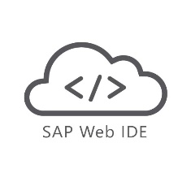

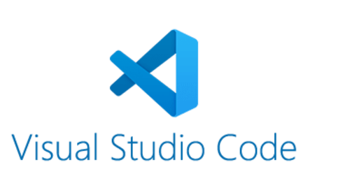
Development Tools
Development Tools
BAS is the latest technology provided by SAP for Development
Web IDE
VS Code
Business Application Studio (BAS)
It Installs in our local system and runs on the browser.
It requires JAVA 1.8 to be installed in system.
It runs offline.
Support for Web IDE is also stopped by SAP in 2019.
It installs in your local system.
It is one of the most used tools in the world by developers.
It is open source.
To develop Fiori Application you don’t need any subscription.
Have large number of plugins to support different languages.
SAP BAS is also based on VS Code.
SAP Business Application Studio is the next generation of the iconic SAP Web IDE.
It comes out of the box with predefined set of development environments – Dev-Spaces (virtual machine on the cloud) tailored for developing SAP business scenarios.

Slide 14
Installation of the Development Tools
VS code:
VS code a open source development tool (IDE) by Microsoft for developer community. Billions of developers across industry use this tool for all kinds of development (web, android, ERP apps, Fiori). Hence SAP also recommend to follow industry best practice. The BAS is a copy of VS Code (local BAS). If you adopt VS Code, you don’t need to buy SAP BAS subscription so it’s a cost saving for company.
Pre-requisites
Node JS to be installed (min v10) – node –v
Download and install NodeJS from here
We need to install SAP UI5 tooling used by Node JS (support module to work with ui5 apps) – npm install –g @ui5/cli
Steps to install VS Code
Download and install VS Code for free from here
Open the VS Code
Add A folder C:\UI5 Project\basics ← project name
Create webapp/index.html file and same content like Web IDE
Run following command by opening terminal in VS Code and go inside project directory
npm init
ui5 init
6. Inside the webapp folder, create a file manifest.json
7. Start web server using command ui5 serve

Slide 15
BAS – Business Application Studio
SAP BTP development is fully supported by a new tool introduced in 2020 called BAS (Business App Studio). It is inspired by Microsoft’s open source dev tool called VS Code.
BAS multi-cloud development tool, which can be used for verity of developments like
Java
Node JS
CAPM
UI5
Fiori
DB Tools
Workflow
Dev Space
Dev Space
Dev Space
Required tools to develop one kind of application.
1..*
workspaces
workspaces
workspaces
workspaces
workspaces
IaaS – AWS, Azure, GCP

Slide 17
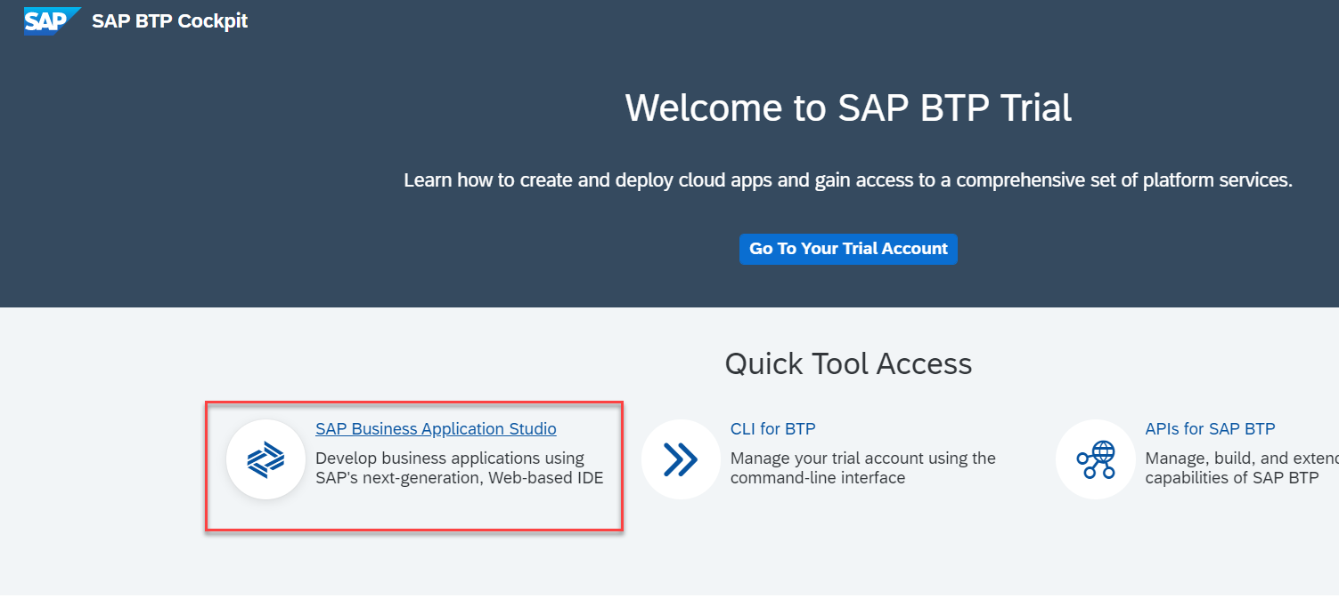
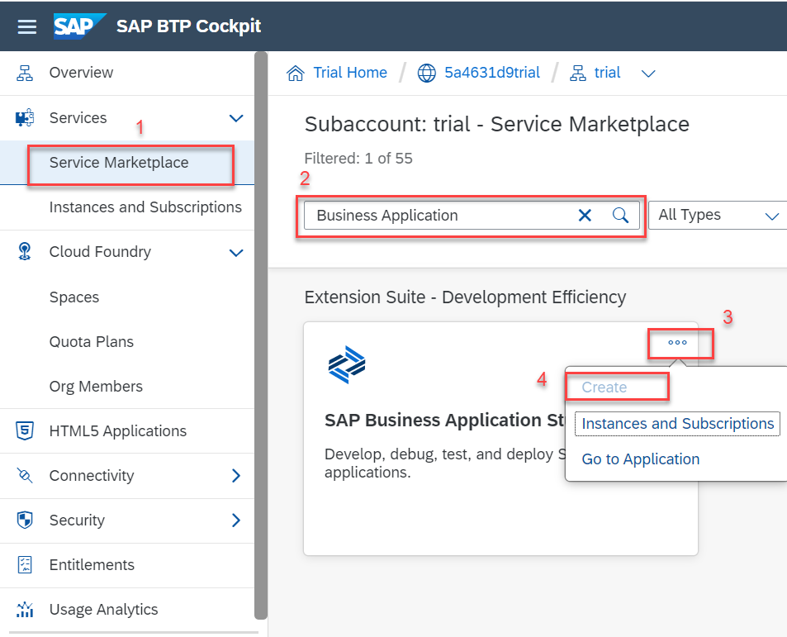
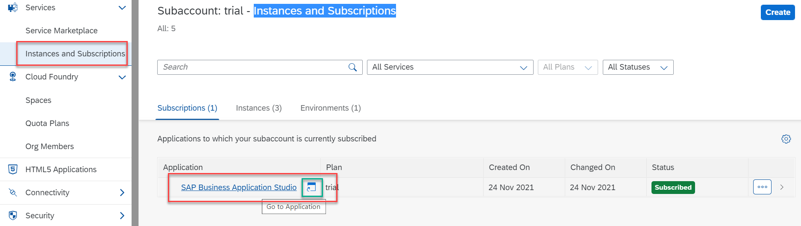
Accessing the BAS Tool
To Access the Business Application Studio we need to go on the home page of the BTP Trial account, and click on the Business Application Studio, it will navigate you to the BAS.
If you are not able to navigate to the BAS from home screen then go to your trial account and in trial account create a subscription for the BAS tool in service market place.
Note:- Its FREE.
Once the instance is created then go to the Instances and Subscriptions section and then start the Business Application Studio.

Slide 18
Additional Tools
Once the setup of Development tools is completed we need to install some other tools in our local system to support the command line interface for the Cloud Foundry and Git.
In BAS these tools are pre-installed.
But in VS Code we have to manually install these tools.
For Git setup: Go to the below link and download the git cli according to your system and install it.
Git Setup - https://git-scm.com/downloads
For Cloud Foundry CLI: Go to below link and download and install the cf cli according to your system type.
CF CLI (Command Line Interface) Tool – allows to communicate/connect to CF
https://github.com/cloudfoundry/cli/wiki/V6-CLI-Installation-Guide
CF CLI help Documentation
https://docs.cloudfoundry.org/cf-cli/getting-started.html

Slide 20
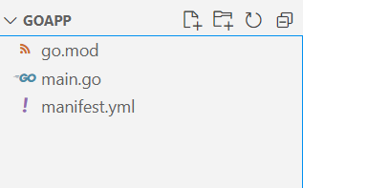
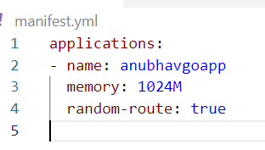
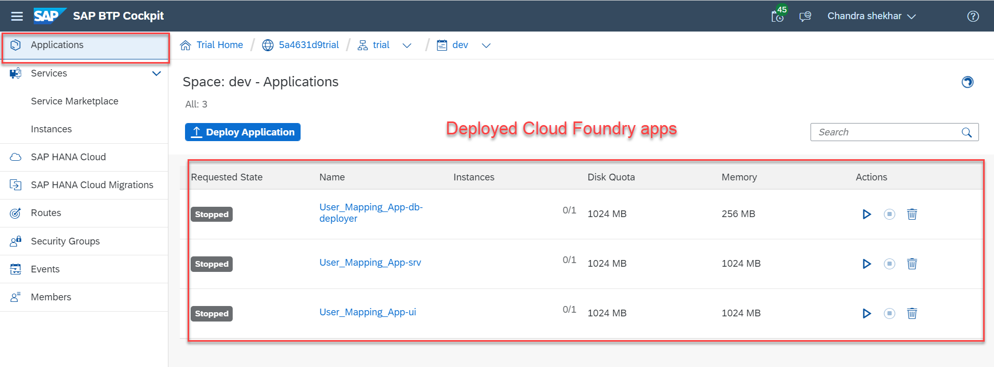
Deploying Sample Application to CF
We will deploy a sample application based on the Go Programming Language.
For now we are just using a basic application. It contains only three files:
go.mod
main.go
manifest.yml
The first two files are some program file, for now we are not focusing on what is written it those file.
The third file is manifest.yml is the most important file in the Cloud Foundry application. It contains the information about application instance, the build pack of the app, route name, memory size required etc.
Steps to deploy the app:
Navigate to the app folder in terminal.
Enter Command ‘cf login’ to login to Cloud foundry.
Enter your login detail
Select the dev space on which you will deploy the app.
Enter command ‘cf push’ to deploy the app to Cloud Foundry.
Once the deployment is successful you can check the application in the BTP’s Application Section.

Slide 21

Hands-on: Deployment of Sample App to CF
In this exercise we will deploy a GO application on the cloud foundry platform.
Exercise code/resource:
GoApp

Slide 22
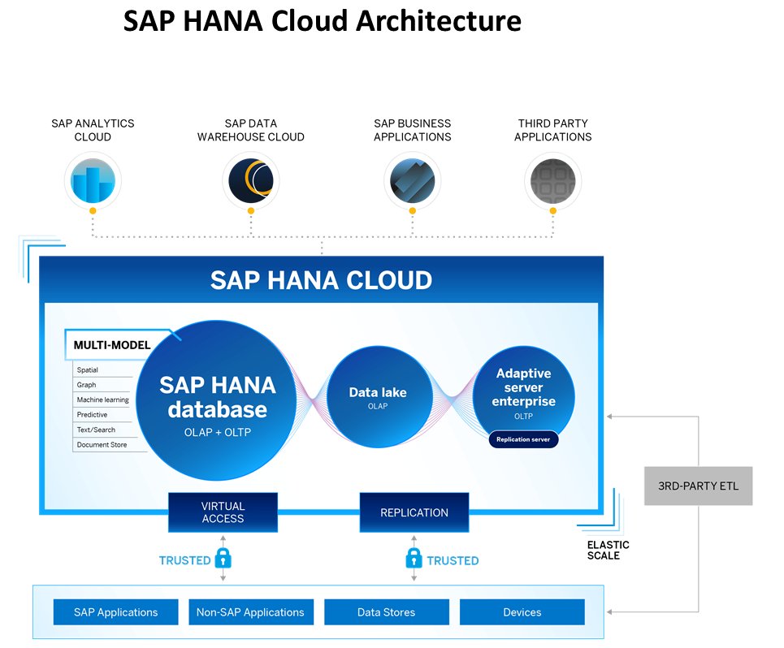
What is SAP HANA Cloud?
SAP HANA Cloud is a fully managed, in-memory, cloud database as a service (DBaaS). It is the cloud-based data foundation for SAP Business Technology Platform. With SAP HANA Cloud you can create, run, and extend new and existing applications.
SAP HANA Cloud includes a number of software components. The core component is SAP HANA Database, but other components can be added at any time, such as a data lake.
Key Components of SAP HANA Cloud
There are four key components of SAP HANA Cloud:
SAP HANA Cloud, SAP HANA Database
In-memory database with built-in advanced analytics (spatial, graph, text, etc.)
SAP HANA Cloud, data lake
Store and query large data sets and most file types
SAP HANA Cloud, adaptive server enterprise
Support for extreme –performance transactional applications
SAP HANA Cloud, adaptive server enterprise replication
Bi-directional real time data replication across databases

Slide 23
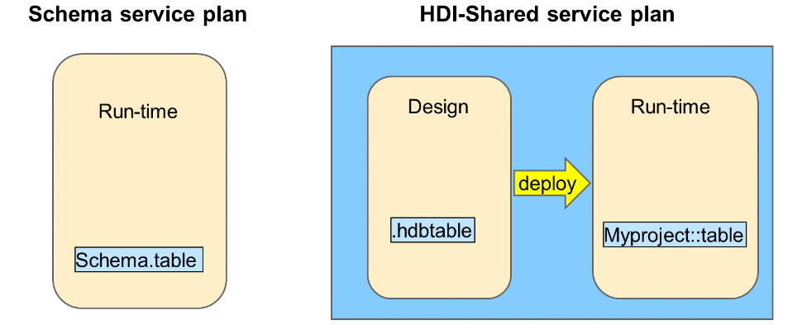
Interfaces and Services in SAP HANA Cloud
Business Application Studio (BAS) - Used by developers to build and maintain applications. Developers include application coders and also data modelers. Business Application Studio is the recommended tool for developing Cloud Foundry applications.
Web IDE - The original interface used by developers to build applications. Although Web IDE can be used with SAP HANA Cloud, it is recommended to use Business Application Studio.
Database Explorer - This is an interface that is used by developers and also administrators. The Database Explorer is used to explore the run-time objects of the database, for example, tables, views and stored procedures.
SAP HANA Cockpit - Used by administrators to monitor the platform, optimize performance, maintain security, and trace and analyze errors.
Service Plans
When you provision an SAP HANA Cloud database, you choose a service plan to manage the database artifacts.
SAP HANA Cloud provides a choice of two service plans for managing database artifacts:
Schema service plan — Create all database artifacts directly to schemas using SQL.
HANA Deployment Infrastructure (HDI) Shared service plan — Provides a combined database design-time and run-time environment. Database developers, using this plan, define all database objects using source files.
NOTE: - A service plan will only be available to you if it was already added as a service entitlement which is done at the Business Technology Platform (BTP) global account level.
Notes:
SAP HANA Cloud provides a choice of two service plans for managing database artifacts:
Schema service plan — Create all database artifacts directly to schemas using SQL. This run-time only option is the approach that has been used for many years with traditional databases and appeals to organizations that only need a database to power their applications and do not require design-time tooling to define the database artifacts as source files. You will manually define schemas to manage your database run-time objects.
HANA Deployment Infrastructure (HDI) Shared service plan — Provides a combined database design-time and run-time environment. Database developers, using this plan, define all database objects using source files. The source files are used to generate and deploy the run-time object to the containers. This plan provides tools for the full life-cycle development and deployment of database artifacts. With this plan you don't have to worry about schemas as these are invisible to the developer and managed by the HDI framework. This is known as schema-less development and provides a flexible re-deployment model as database artifacts are not hardwired to schemas.
A service plan will only be available to you if it was already added as a service entitlement which is done at the Business Technology Platform (BTP) global account level.
A service plan is chosen when you create a new Instance. An Instance belongs to a Space

Slide 24
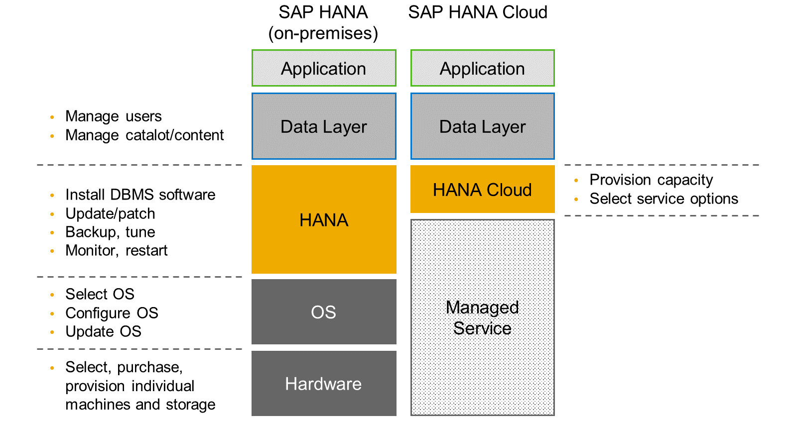
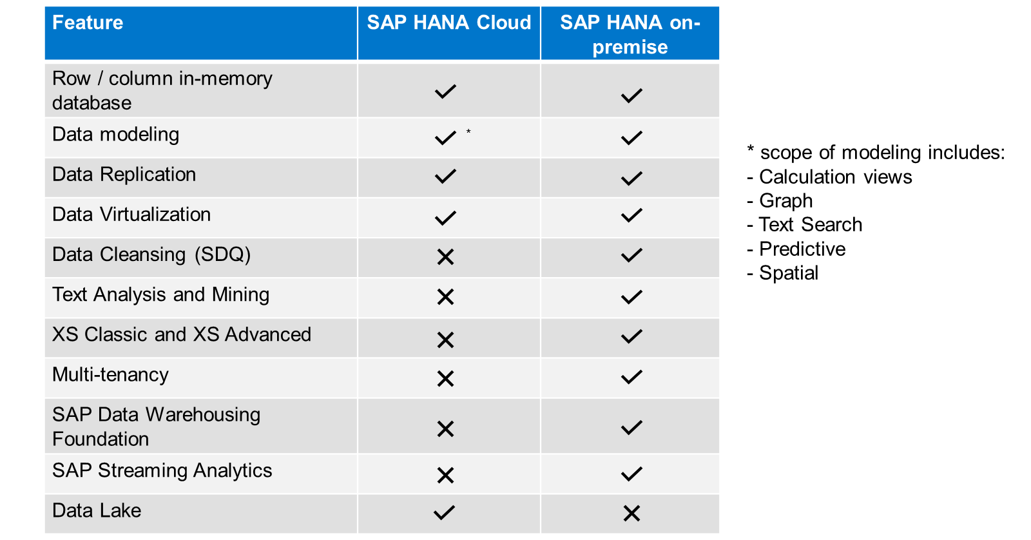
SAP HANA Cloud vs. SAP HANA on-premise
Feature Differences
SAP HANA Cloud compares very closely with SAP HANA on-premise in terms of features but there are some differences.

Slide 25
HDI Container
An HDI Container is also a schema. But it is managed differently from a normal schema.
How its created?
Manually create it in BTP
Application Managed HDI Container (You as developer ONLY work with App, App will talk to HANA to create and manage this schema to store/read data internally)
You cant access HDI Container using HANA Studio (Deprecated tool), We can use new SAP HANA Database Explorer, SAP HANA WebIDE for OP or BAS to access HDI Container.
Who creates it?
There is a new service in SAP HANA called SAP HDI (HANA Deployer Infrastructure) which is just a microservice responsible to managing the container. HDI Deployer is a component which is used to talk to this service from our app.
Who owns it?
The moment HDI Container is created, 2 users will gets created automatically by system in HANA.
RANDOMGUID_DT (Design Time) – Full permission to CREATE< DROP< ALTER DB object
RANDOMGUID_RT (Runtime User) – Only permissions to INSERT, UPDATE, DELETE data…
In case of app wants to talk to hana, these users will be used by our app. The same user will be available as environment variable in CF, VCAP_SERVICE.

Slide 26
HDI and Container
HDI (HANA Deployment Infra) Service
HANA DB (shared-db)
HDI Container
HDI Container
HDI Container
HDI Container
HDI Container

Slide 27
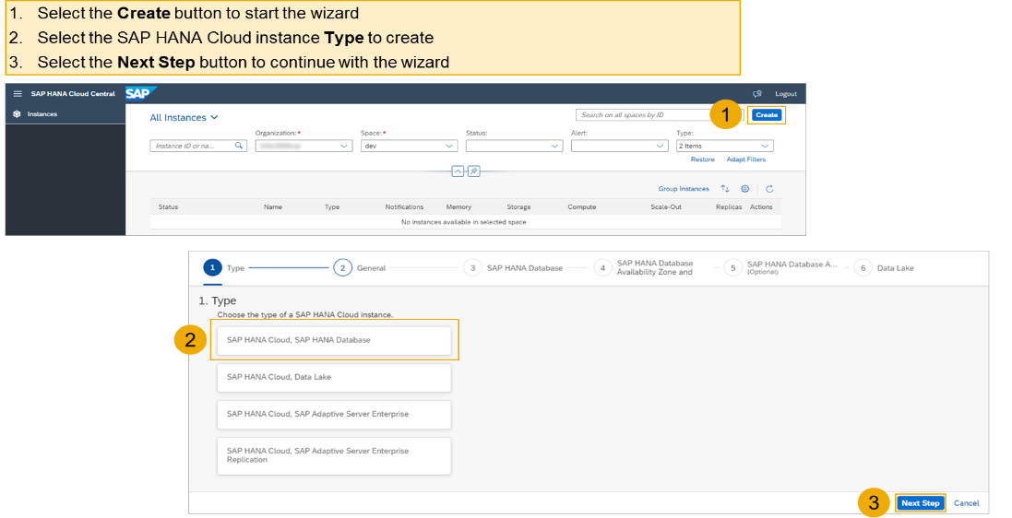
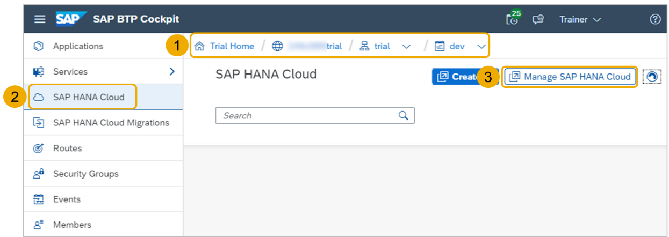
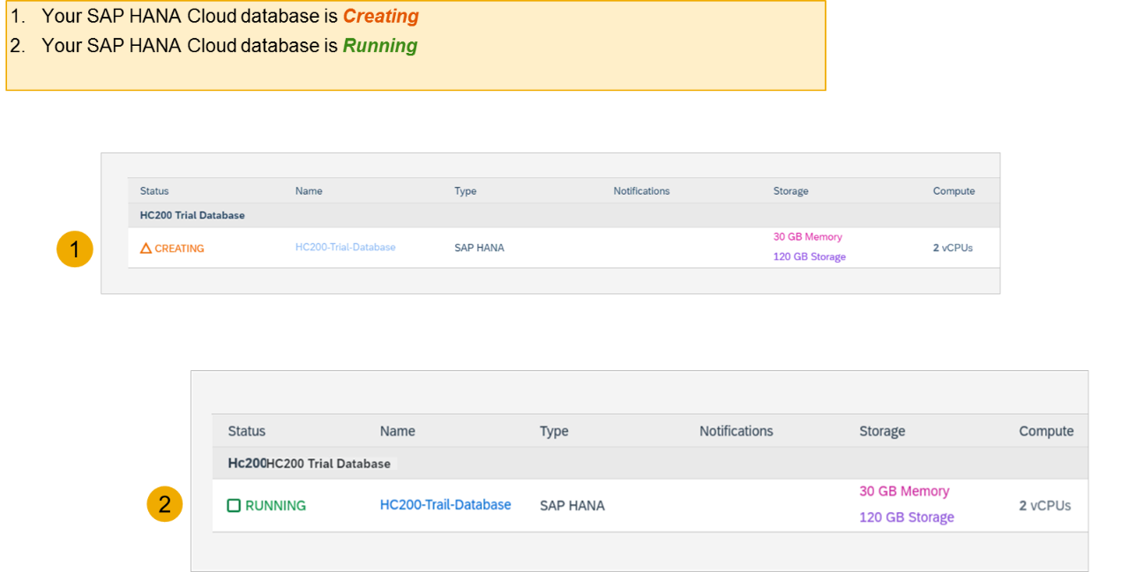
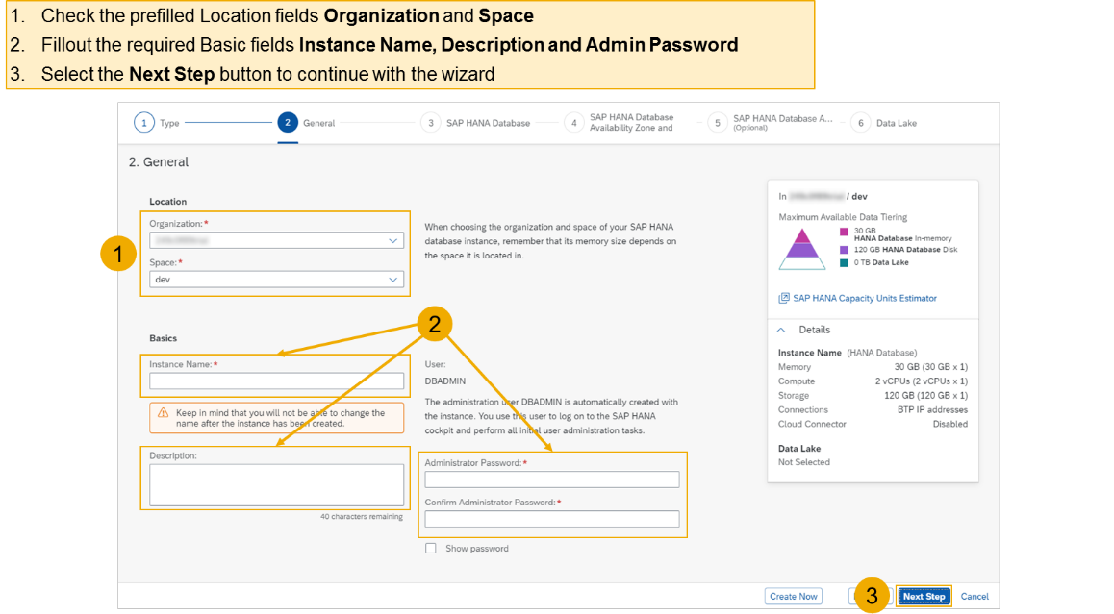
Creating SAP HANA Cloud Instance
Login to your trial and navigate to your dev space
Select SAP HANA Cloud
Select the Manage SAP HANA Cloud button to start the SAP HANA Cloud Central
Select the Create button to start the wizard
Select the SAP HANA Cloud instance Type to create
Select the Next Step button to continue

Slide 28

End of Day 1

Slide 29

Questions

Slide 30

Anubhav Oberoy

Slide 31


We’re committed to empower you to be
Most Desirable Resource
through powerful training solutions.
We build the workforce of the future.
250+
Corporate Clients
30,000+
Learners Trained
25000+
Learners Placed
FREE WEBINARS
Sign up for free webinars with industry experts every fortnight!
Enroll Now!
Contact us today!
https://anubhavtrainings.com/

Slide 32




More from AnubhavTrainings.com

Slide 33
Title
Content

